Slide 1

Introductory Level
Course Rep Training
Helen Chisholm
Amy Hamilton

Slide 2

Learning outcomes
  Explore your understanding of your role as a Class Rep
  Discuss the student learning experience and explored how you can use it to improve your course’s collective experience
  Develop some of the skills you will use as Class Rep

Slide 3

Class Reps in
Borders College
Each academic year, every
class elects someone
(under secret ballot)
to take forward their class
views to the
Faculty Council meetings.

Slide 4
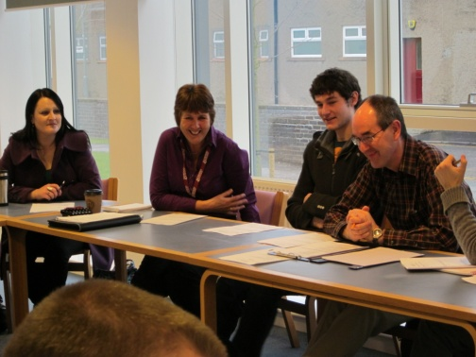
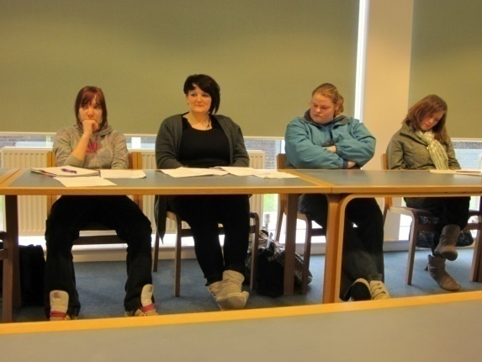
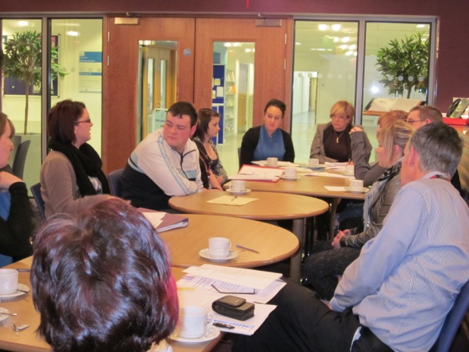
Faculty Council Meetings
These are attended by:
Faculty’s Class Reps
Head of Faculty
Programme Leaders
Lecturer
Vice Principal
Students Association

Slide 5
Faculty Council Chair
Faculty Council meetings -
3 per year (Nov, Feb and April/May)
Chaired by a Class Rep from the previous year
Election for Chair held at the April/May meeting
Each Faculty Council Chair automatically becomes a member of the Borders College Students Association Student Representative Council.

Slide 6
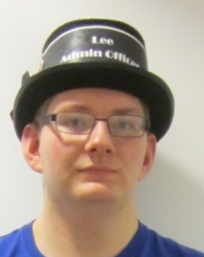
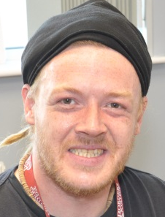
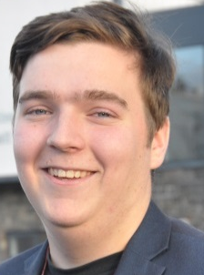
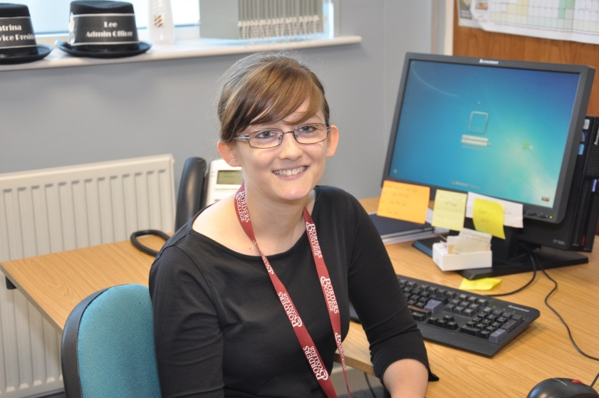
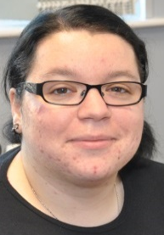
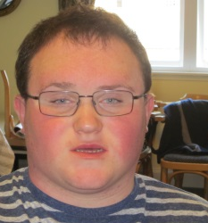
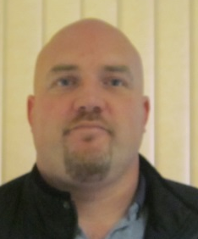
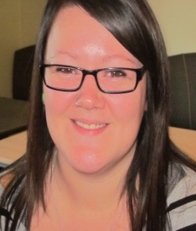
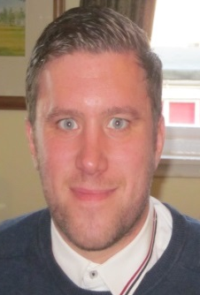
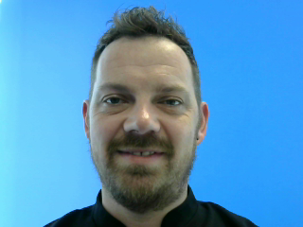
Admin Officer
VP
President
VP
Equalities Officer
Student Representative
Council
Access Chair
Construction Chair
Business Chair
Care Chair
Landbased Chair
Creative Industries Chair

Slide 7
Student Representation on College Committees
Students
Association
Executive
Committee
Committees:
Academic Board
Board of Management
Campus Management
Curriculum & Quality
Enrolment
Equality & Diversity
Finance
FM Users
Health & Safety
ICT Users
Library Users
Sustainability
Student Representative Council
=
+
Faculty
Council
Chairs

Slide 8
Why have Class Reps?
In small groups, discuss why you think it is so important to have Class Reps, what their role is. what skills they need and what they get out of it.

Slide 9
Rep skills
Communication
Networking
Relationship building
Reflection
Presentation
Listening
Organisation.
Report writing.
Diplomacy.
Negotiation.
Research.
Time management / prioritisation.

Slide 10
Dominoes

Slide 11




Slide 12


Slide 14
Attending
Faculty Council meetings
Think about what you would do:
  Before you to go to the meeting?
  During the meeting?
  After the meeting?

Slide 15
Before a meeting
Where and when is the meeting going to take place?
Find out what your classmates think about their learning experience.
Is there anything you want to put on the agenda? Get in touch with the Chair/Administrator.
Read any of the papers that have been sent round, including the previous meeting’s minutes.
Speak to other Class Reps.

Slide 16
Gathering student opinion
Hands up before/after class
Emails
Face to face chats
Online spaces:
  Facebook
  Twitter
  Virtual Learning Environments (VLE)
Surveys
Post it notes in tutorials
Comment boxes

Slide 17
During a meeting
Always be on time, if you are going to be late let the Chair/Administrator know before the meeting.
Take a pen and paper for notes.
Sit where the chair can see you and raise your hand to indicate you want to contribute.
Ask questions if you do not understand anything.
Support other Class Reps in the meeting.
Remember the A, B, C and D of effective feedback.

Slide 18
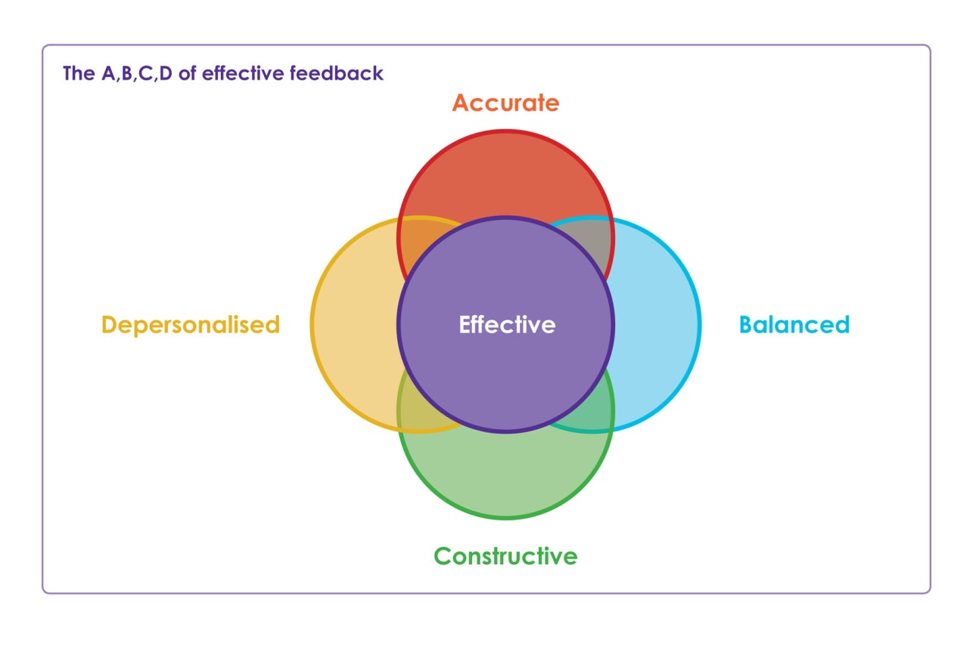
The A,B,C,D of Effective Feedback

Slide 19
keep
K
I
improve
S
stop
S
start

Slide 20
After a meeting
Report back to your classmates.
Check the minutes.
Do anything you have been asked to do.
Follow up any areas of concern.
Did you achieve what you wanted to achieve? If not what are you going to do about it?

Slide 21
Closing the loop
Feedback
Identify
the issue
Don’t forget to
FEEDBACK
what you have achieved!!
Develop &
implement
the solution

Slide 22
Partnership Activity

Slide 23
What’s the Purpose?
Help us understand the issues students face at college
Help us understand how students choose to interact with their college
Help us decide what the college and students association should work on together over the next academic year

Slide 24
What is a Student Partnership Agreement?
Section A
Describes ways in which students can affect change at college.
Section B
Describes the areas which the college and students’ association agree to work on together over the next year.

Slide 25
How Will We Develop Our Partnership Agreement?
Speak to students
Speak to staff
Present Partnership Agreement to Board of Management
Sign the Agreement

Slide 26
Task 1
5 minutes
Think of one thing you would like to change about your college, or one problem you’ve had with it.
Feedback to group

Slide 27
Task 2
5 minutes
Go through each example from task 1. Think about the different ways in which you, as a student, could solve each problem. Give as much detail as possible.
Feedback to group

Slide 28
Task 3
5 minutes
Rank the issues from task 2 in terms of importance
Feedback to group

Slide 29
Support available to you
Your Students’ Association/College.
Online training resources are available via www.sparqs.ac.uk
NUS Scotland, the national representative body, can support you. Visit www.nus.org.uk for more information.
Facebook group

Slide 30
Your future Rep career
Online training resources are available via www.sparqs.ac.uk
If you’re interested in becoming a sparqs Associate Trainer, recruitment days will be held in March/April 2015.
For further info about any of these opportunities, contact Stephanie Millar at stephanie.millar@sparqs.ac.uk or phone 0131 622 6599.

Slide 31
Your future Rep career
Online training resources are available via www.sparqs.ac.uk
If you’re interested in becoming a sparqs Associate Trainer, recruitment days will be held in March/April 2015.
For further info about any of these opportunities, contact Stephanie Millar at stephanie.millar@sparqs.ac.uk or phone 0131 622 6599.

Slide 32
Learning outcomes for today
Reflecting on today’s training, you have;
  Explored your understanding of your role as a Class Rep and the importance of effective communication
  Discussed the student learning experience and explored how you can use it to improve your course’s collective experience
  Developed some of the skills you will use as Class Rep

Slide 33
Thank you for attending our Introductory Level Class Rep Training and for your help with the Partnership Agreement!
Please fill in your evaluation forms and hand them in.
Helen Chisholm Amy Hamilton
Liaison Officer Development Officer
hchisholm@borderscollege.ac.uk ahamilton@borderscollege.ac.uk

